Slide 1
Flow Control Statements
Flow control statements play a very important role as they allow you to control the flow of execution of a script inside a function. The most commonly used flow control statements are represented in the below image:

Slide 2
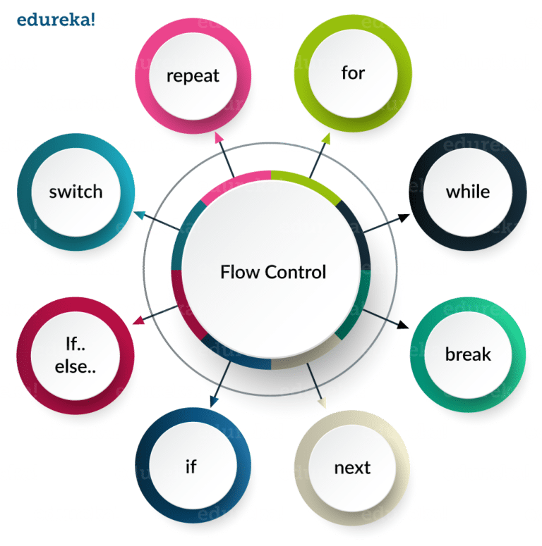

Slide 3
Selector Statements
If control Statement: This control statement evaluates a single condition. It is quite easy as it just has a single keyword “if” followed by the condition and then certain set of statements that needs to get executed in case it is true. Refer to the below flowchart to get a better understanding:

Slide 4
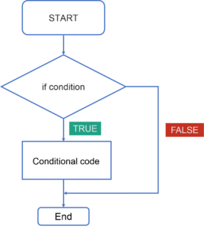

Slide 5
In this flowchart, the code will respond in the following way:
First of all, it will enter the loop where it checks the condition.
If the condition is true, conditional code or the statements written will be executed.
If the condition is false, the statements gets ignored.
Below is an example of if control statement in R. Try running this example in R Studio
X =2
repeat {
x= x^2
print(x)
if(x>100) {
break
}
Output :
[1] 4
[1] 16
[1] 256

Slide 6
If Else Control Statement : This type of control statement evaluates a group of conditions and selects the statements. Refer to the below flowchart to get a better understanding:

Slide 7
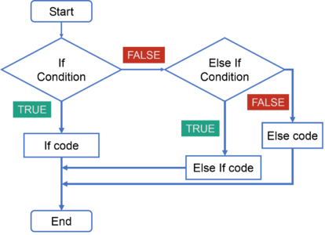

Slide 8
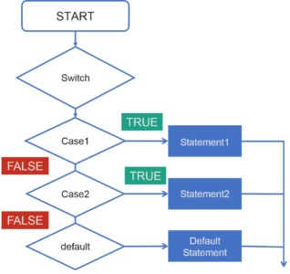
Switch Statements: These control statements are basically used to compare a certain expression to a known value. Refer to the below flowchart to get a better understanding:

Slide 9
In this Switch case flowchart, the code will respond in the following steps:
First of all it will enter the switch case which has an expression.
Next it will go to Case 1 condition, checks the value passed to the condition. If it is true, Statement block will execute. After that, it will break from that switch case.
In case it is false, then it will switch to the next case. If Case 2 condition is true, it will execute the statement and break from that case, else it will again jump to the next case.
Now let’s say you have not specified any case or there is some wrong input from the user, then it will go to the default case where it will print your default statement.

Slide 10
Below is an example of switch statement in R. Try running this example in R Studio.
vtr <- c(150,200,250,300,350,400)
option <-"mean"
Switch
(option,
"mean" = print(mean(vtr)),
"mode" = print(mode((vtr))),
"median" = print(median((vtr)))
)
Output :
[1] 275

Slide 11
Loop Statements
Loops help you to repeat certain set of actions so that you don’t have to perform them repeatedly. Imagine you need to perform an operation 10 times, if you start writing the code for each time, the length of the program increases and it would be difficult for you to understand it later. But at the same time by using a loop, if I write the same statement inside a loop, it saves time and makes easier for code readability. It also gets more optimized with respect to code efficiency.

Slide 12
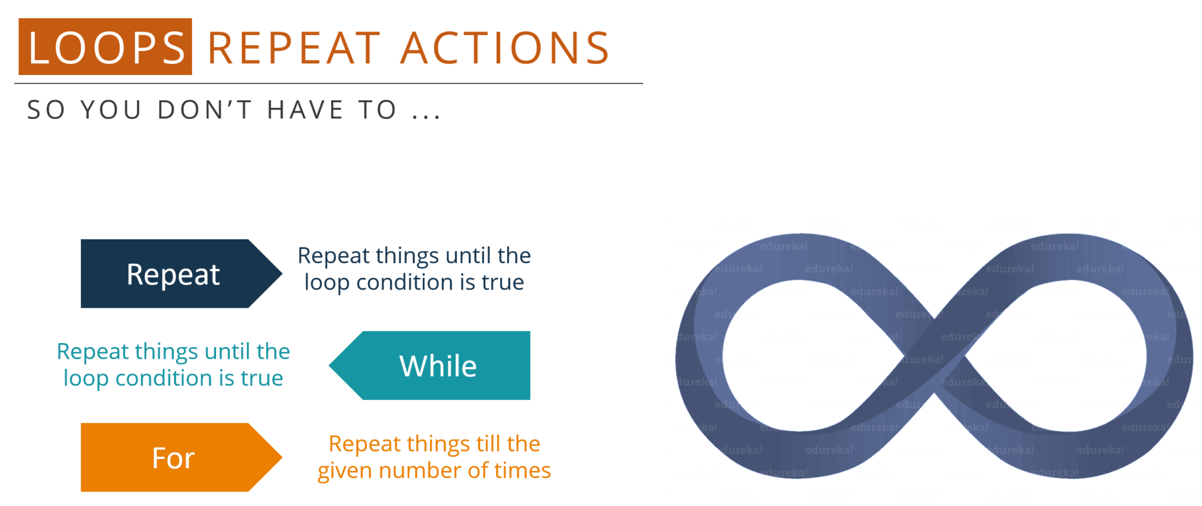

Slide 13
n the above image, ‘repeat’ and ‘while‘ statements help you to execute a certain set of rules until the condition is true but’ for’ is a loop statement that is used when you know how many times you want to repeat a block of statement. Now, if you know that you want to repeat it for 10 times, then you will go with ‘for’ statement but if you are not sure about how many times you want the code to be repeated, you will go with ‘repeat’ or ‘while’ loop.

Slide 14
Let’s discuss each one of them with examples.
Repeat: The repeat loop helps to execute the same set of code again and again until a stop condition is met. Refer to the below flowchart to get a better understanding:

Slide 15
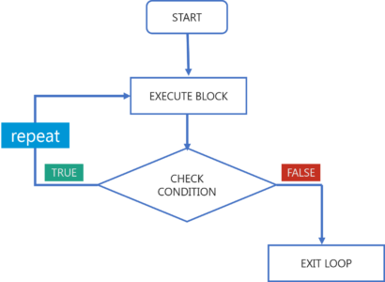

Slide 16
In the above flowchart, the code will respond in the following steps:
First of all it will enter and execute a set of code.
Next it will check the condition, if it is true it will go back and execute the same set of code again until it is meant to be false.
If it is found to be false, it will directly exit the loop.

Slide 17
While: The while statement also helps to execute the same set of code again and again until a stop condition is met. Refer to the below flowchart to get a better understanding:

Slide 18
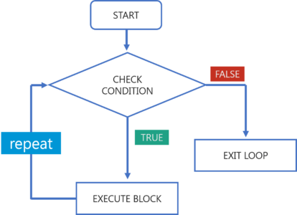

Slide 19
In the above flowchart, the code will respond in the following steps:
First of all it will check the condition.
If it is found to be true, it will execute the set of code.
Next, it again checks the condition, if its true it will execute the same code again. As soon as the condition is found to be false, it immediately exits the loop.

Slide 20
Below is an example of while statement in R. Try running this example in R Studio.
x=2
while(x<1000)
{
x=x^2
print(x)
}
Output:
Output:
4
16
256
65536

Slide 21
So you must be wondering how these two statements differ? Let me clear your doubt! Here the major difference between the repeat and while statement is that it changes with respect to your condition. While loop basically defines when you are going to enter the loop to execute the statements and repeat loop defines when you leave from the loop after the execution of the statements. So these two statements are known as entry control loop and exit control loop. That’s how while and repeat statements are different.

Slide 22
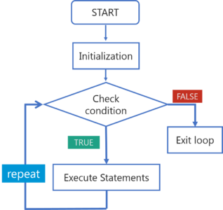

Slide 23
For Loop: For loops are used when you need to execute a block of code several number of times. Refer to the below flowchart to get a better understanding:

Slide 24
In the above flowchart, the code will respond in the following steps:
First of all there is initialization where you specify how many times you want the loop to repeat.
Next, it checks the condition. If the condition is true, it will execute the set of code for the specified number of times.
As soon as the condition is found to be false, it immediately exits the loop.

Slide 25
Below is an example of for statement in R. Try running this example in R Studio.
1 vtr <- c(7,19,25,65, 45)
2 for( i in vtr) {
3 print(i)
4 }
Output :
7
19
25
65
45

Slide 26
Jump Statements
Break Statement: Break statements help to terminate the program and resumes the control to the next statement following the loop. These statements are also used in switch case. Refer to the below flowchart to get a better understanding:

Slide 27
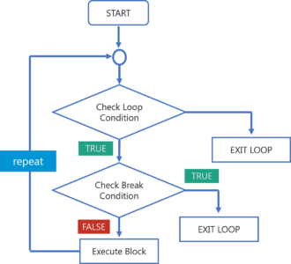

Slide 28
In the above flowchart, the code will respond in the following steps:
First of all, it will enter the loop where it checks the condition.
If the loop condition is false, it directly exits the loop.
If the condition is true, it will then check the break condition.
If break condition is true, it exists from the loop.
If the break condition is false, then it will execute the statements that are remaining in the loop and then repeat the same steps.

Slide 29
Below is an example of jump statement in R. Try running this example in R Studio.
x <- 1:5
for (val in x) {
if (val == 3){
break
}
print(val)
}
Output:
[1] 1 [1] 2

Slide 30
Next Statement: A next statement is used when you want to skip the current iteration of the loop without terminating it. Next statement is quite similar to ‘continue’ in other programming language. Refer to the below flowchart to get a better understanding:

Slide 31
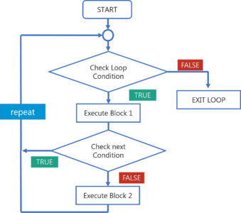

Slide 32
In the above flowchart, the code will respond in the following steps:
First of all, it will enter the loop where it checks the condition.
If the loop condition is false, it directly exits the loop.
If the loop condition is true, it will execute block 1 statements.
After that it will check for ‘next’ statement. If it is present, then the statements after that will not be executed in the same iteration of the loop.
If ‘next’ statement is not present, then all the statements after that will be executed.

Slide 33
Below is an example of next statement in R. Try running this example in R Studio.
for(i in 1:15)
{
if((i%%2)==0) {
next
}
print(i)
}
Output :
1 3 5 7 9 11 13 15

